Slide 1
Lecture 12 NP and NP-completeness
NP
NP-completeness (Cook-Levin Theorem)
Typical NP-complete examples

Slide 2


Efficient algorithms
PCP
A_{TM}
The running time of an algorithm depends on the input
For longer inputs, we allow more time
Efficiency is measured as a function of input size
decidable
EQPDA
inefficient
HALTTM
brute-force search
efficient

Slide 3
Time complexity
Let M be a deterministic TM that halts on all inputs. The running time or time complexity of M is the function f: N ->N, where f(n) is the maximum number of steps that M uses on any input of length n. If f(n) is the running time of M, we say that M runs in time f(n) or M is an f(n)-time TM.
Worst-case analysis

Slide 4
Polynomially equivalent
Polynomially equivalent: any one of them can simulate another with only a polynomial increase in running time.
All reasonable deterministic computational models are polynomially equivalent.
  The aim is to present the fundamental properties of computation, rather than properties of models of computation.
  A problem can solved in polynomial time on a typical computer iff it can be solved in polynomial time by a deterministic TM.

Slide 5
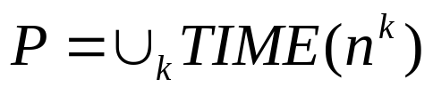
The class P: defining “efficient algorithm”
Time complexity class TIME(t(n))={L:L is a language decided by an O(t(n)) time TM}
P is the class of languages that are decidable in polynomial time on a deterministic single-tape TM. In other words,
  Our strategies so far are
    Reasonable representation of input
    Deterministic models of computation
    Asymptotic analysis
  P roughly corresponds to the class of problems that are realistically solvable on a computer.
  P in complexity theory is similar to decidability in computability theory

Slide 6
Where are we now?
PCP
A_{TM}
Brute-force search
PATH
REGULAR (o(nlogn))
CFL (O(n^3))
Dynamic Programming
Greedy algorithm
decidable
EQPDA
inefficient
HALTTM
efficient

Slide 7
Extension of Church-Turing thesis
=
Intuitive notion
of algorithm
Turing machine
algorithm
Polynomial by a
realistic computer
Polynomial by
a one tape DTM
=

Slide 8
What is the intuition of NP?
Solving a math homework problem by yourself is usually much harder than reading and understanding a solution provided by your instructor.
The usual explanation for this difference of effort is that finding a solution to a math problem, requires creative effort. Verifying a solution is much easier since somebody else has already done the creative part.

Slide 9
Extension of Church-Turing Thesis
NP aims to capture the set of problems whose solutions can be efficiently verified.
the class P contains decision problems that can be efficiently solved.

Slide 10
NP in terms of polynomial-time verifier
A verifier for a language A is an algorithm V, where
A={w: V accepts <w,c> for some string c}
We measure the time of a verifier only in terms of the length of w, so a polynomial time verifier runs in polynomial in the length of w. A language A is polynomial verifiable if it has a polynomial time verifier.
NP is the class of languages that have polynomial time verifier.
For polynomial verfiers, the certificate has polynomial length.

Slide 11
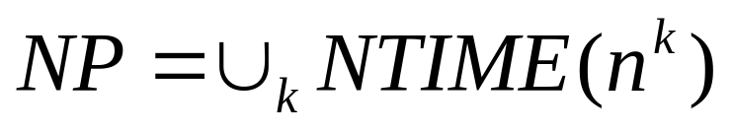



















NP in terms of nondeterministic TM
(Equivalent characterization) A language is in NP iff it is decided by some nondeterministic polynomial time TM.
Let NTIME(t(n))={L: L is a language decided by a O(t(n)) time nondeterministic TM}. Then

Slide 12
Computation tree of nondeterministic TM
nondeterminism
2
Each node is a configuration
1
2
3
1
2
3
1
……..
f(n)
reject
……..
………
accpet
reject

Slide 13
Simulating NTM with DTM
0
0 0 1 0 u
Input tape
Never altered
D
x
X x # 0 1 x u
Simulation tape
Simulate one branch of computation
1
1 2 3 3 2 3 1 2 1 1 3 u
Address tape
Update according to the lexicographical order

Slide 14


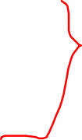






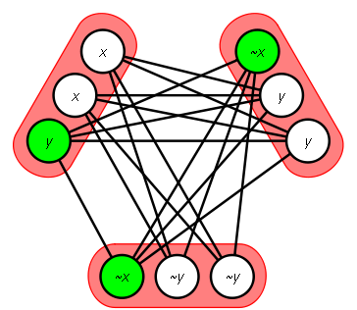















Clique problem: an example in NP
A clique is a subgraph where every two nodes are connected. A k-clique is a clique that contains k nodes.

Slide 15

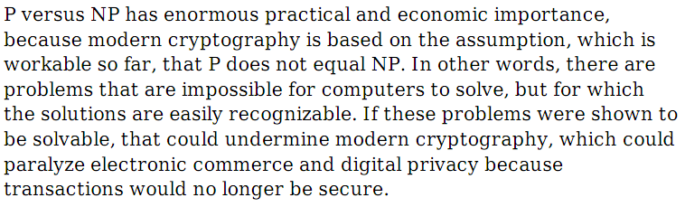




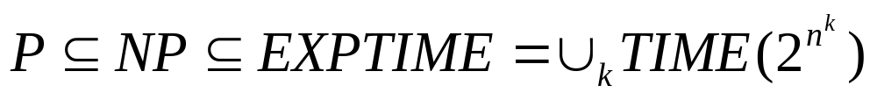




N vs NP (one of 7 Millennium problems)
Shor's algorithm and Quantum Computation.

Slide 16
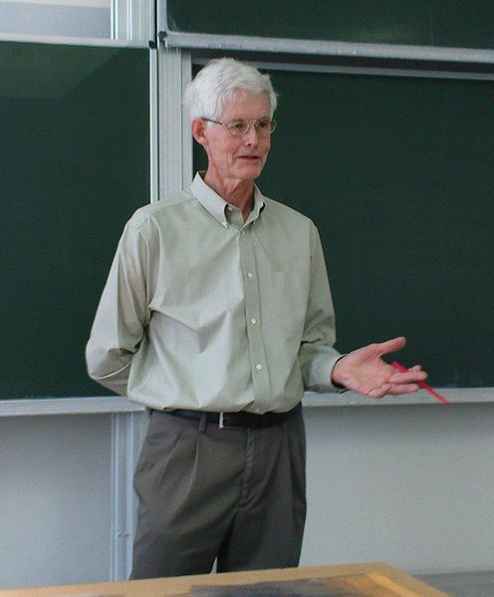
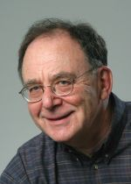
S. Cook and R. Karp
S. Cook
(1939-)
R. Karp
(1935-)

Slide 17
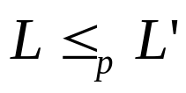


Polynomial-time reduction
A language L is polynomial time mapping reducible to language L', written , if a polynomial time computable function exists, where for every w,
A
B
f

Slide 18


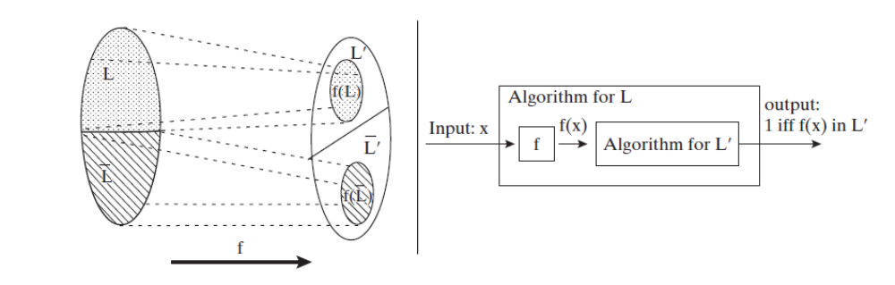






Polynomial-time reduction
If A <=B and B is in P, then A is in P.

Slide 19














NP-complete
A language B is NP-complete if it satisfies two conditions:
B is in NP;
Every A in NP is polynomial time reducible to B.
  If B is NP-complete and B<=C for C in NP, then C is NP complete.

Slide 20
Boolean logic
A Boolean formula is an expression that constructed from Boolean variables x, y,.. through operations AND, OR and NOT.
A Boolean formula is satisfiable if some assignment of 0s and 1s to the variables makes the formula evaluate to 1.

Slide 21


Satisfiability problem
A Boolean formula is generated by the following grammar:
Let V be the set of variables. A truth assignment is a mapping from V to {0,1}. A formula is satisfied by a truth assignment if this assignment makes the formula evaluate to 1.
The satisfiability problem is to test whether a formula is satisfiable: SAT={< >: is a satisfiable Boolean formula}

Slide 22
SAT is NP-complete (Cook and Levin)
Proof idea: Main Steps:
First note that SAT is in NP.
Next we fix a language A in NP and show that A is polynomial reducible to SAT. Let N be a nondeterministic TM that decides A in n^k time for some constant k. The main goal is to construct a formula in polynomial time such that
  N accepts w iff the corresponding formula is satisfiable.

Slide 23
Accepting tableau: computation history
# | q0 | w1 | W2 …. Wn B B ………. B | #
#
#
 |  |  | window
# |  |  |  | #
Start configuration
Second configuration
n^k
accepting configuration
n^k

Slide 24
Reduction and analysis
Every accpeting tableau for N on w corresponds to a computation branch of N on w;
The problem whether N accepts w is equivalent to the problem of determinign whether an accepting tableau for N on w exists.
  Compare the following proof to that for undecidability of PCP.

Slide 25


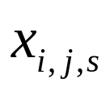
Describing accepting tableau in terms of Boolean formula
Q and are the state set and tape alphabet of N. Denote
For each i and j between 1 and n^k and for each s in C, we have a variable
A cell is an entry of the tableau.
If the variable takes on the value 1, it means that cell[i,j] contains an s.

Slide 26
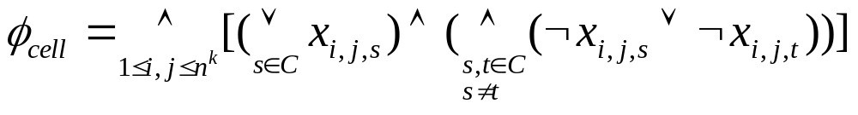
Requirement for the setting
Obtain a correspondence between an assignment and a tableau so that the assignment turns on exactly one variable for each cell.

Slide 27
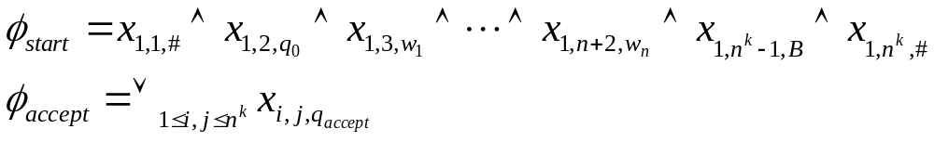
Requirements for start and accept
The first row is the starting configuration and an accepting configuration occurs in the tableau.

Slide 28
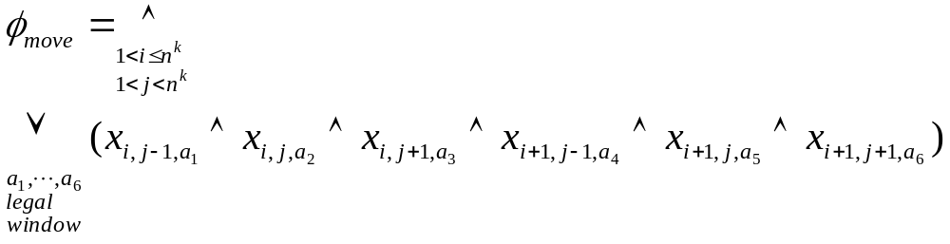
Requirement for transition
A 2 times 3 window is legal if that window does not violate the actions specified by N’s transition function.
(the (i,j) window is legal)

Slide 29
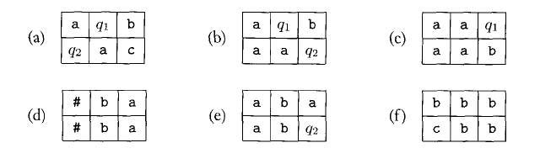
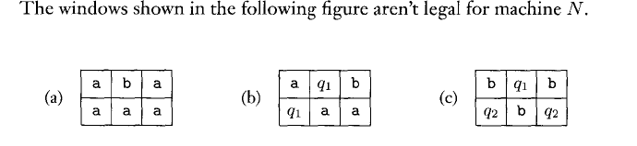
Legal windows

Slide 30



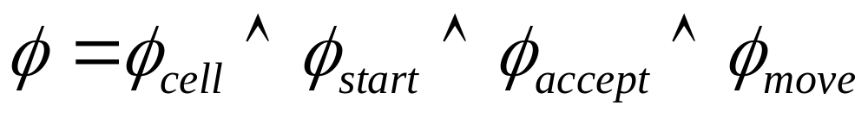
Polynomial time reduction
The problem whether N accepts w is reduced to the problem whether the formula
is satisfiable and the reduction is in polynomial time.
N accepts w iff the formula is satisfiable.

Slide 31





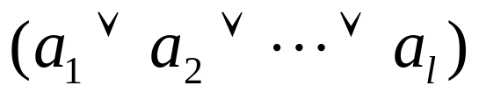











3-SAT is NP-complete
Convert the CNF into one with three literals per clause
Replace
with
  the original formula is satisfiable iff the new one is satisfiable.

Slide 32







CLIQUE is NP-complete
Two exceptions:
1) Nodes in the same triples
2) Nodes with contradictory labels
-x1
-x2
-x2
-x1
x2
x2
x1
x2
x2
The formula is satisfiable iff the constructed graph has a k-clique.

Slide 33
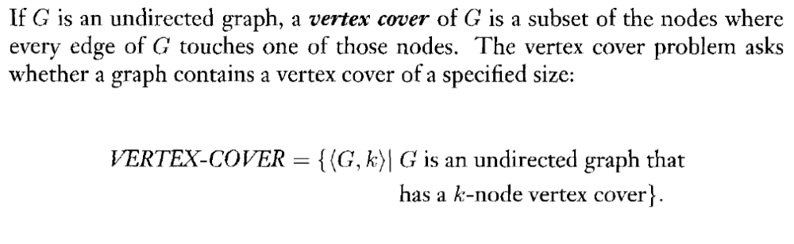

Vertex-cover problem

Slide 34





































VERTEX-COVER is NP-complete
The nodes in each gadget
Are connected to each other
They are also connected to the
Nodes in the variable gadgets with
The same labels.
x1
-x1
x2
-x2
x1
-x1
-x1
x1
x2
-x2
-x2
x2
x2

Slide 35
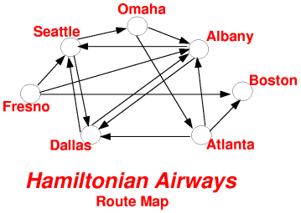
Hamiltonian Path Problem

Slide 36
HAMPATH is NP-complete
HAMPATH={<G,s,t>: G is a directed graph containing a path from s to t that goes through every node exactly once}
Proof idea: The variable gadgets are diamond structures that can be traversed in either of 2 ways and the clause gadgets are simple nodes.

Slide 37
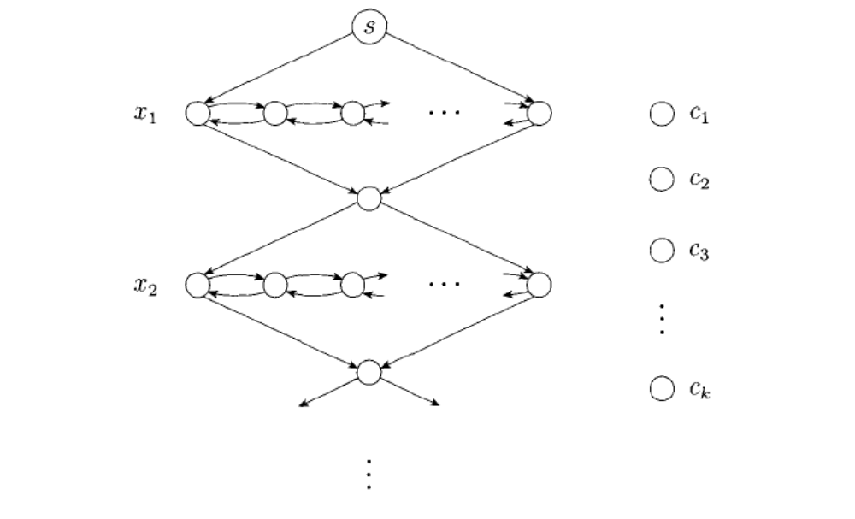
Polynomial time reduction

Slide 38
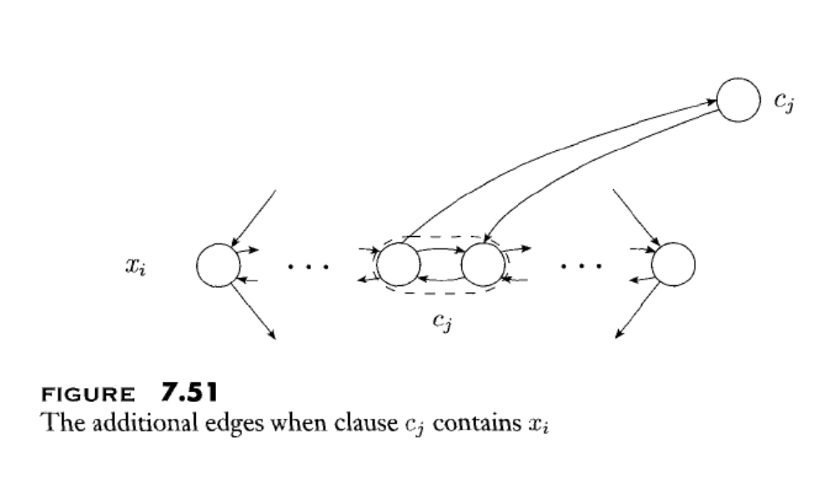
Connecting diamonds to nodes

Slide 39

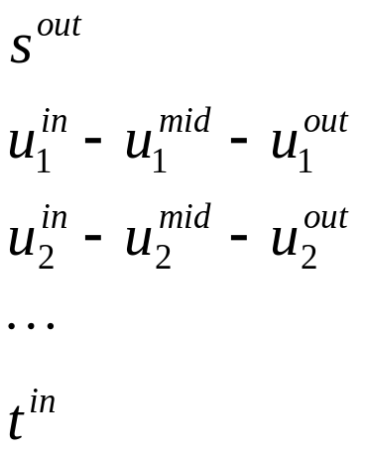
UHAMPATH is NP-complete
Proof idea: The reduction takes a directed graph G with nodes s and t, and construct a undirected graph G’ with nodes s’ and t’. A Hamiltonian path P in G
has a corresponding Hamiltonian path P’ in G’.

Slide 40
Traveling salesman problem (TSP)
Input: A graph with integer weights on the edges and a weight limit W.
Question: does the graph have a Hamilton circuit of total wieght at most W.

Slide 41
Traveling salesman problem (TSP)
TSP is NP-complete.
Proof idea: Given a graph, construct a weighted graph G’ whose nodes and edges are the same as the nodes and edges of G, with a weight of 1 on each edge, and a limit k that is equal to the number of nodes n of G.
A Hamiltonian circuit of weight n exists in G’ iff there is a Hamilton circuit in G.
  A Hamilton circuit is a set of edges that connect the nodes into a single cycle, with each node appearing exactly once.

Slide 42
Subset-sum problem
Input: given a collection of numbers togther with a target number t
Ask: does the collection contain a subcollection that adds up to t.

Slide 43
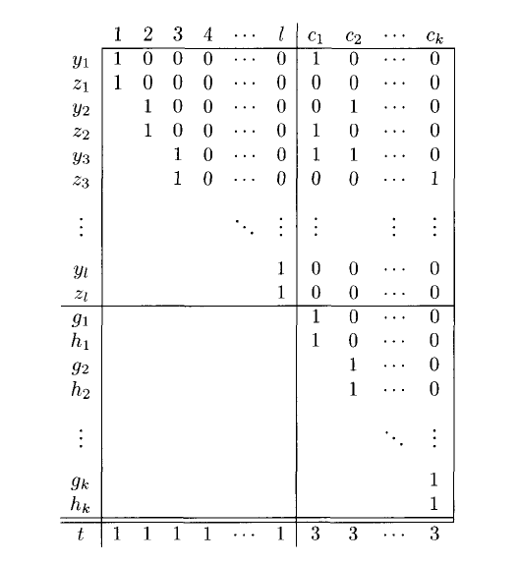

Slide 44
The Problem of Independent sets
For an undirected graph, a subset I of the nodes of G is an independent set if no two nodes are connected by an edge of G
Input: A graph G and a lower bound k
Ask: does G have an independent set of size k.

Slide 45
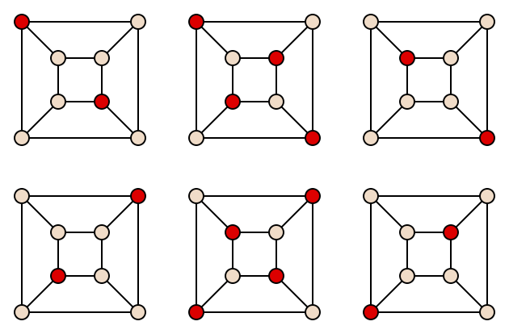
An example

Slide 46
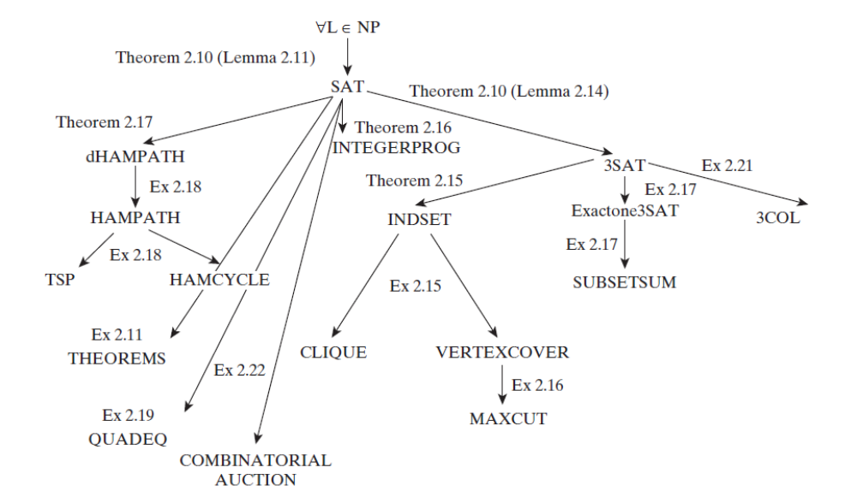














Web of reductions between NP-complete problems

Slide 47
Where are we now?
PCP
A_{TM}
SAT
3-SAT
CLIQUE
Vertex-Cover
SUBSET-SUM
HAMPATH
PATH
REGULAR (o(nlogn))
CFL (O(n^3))
Dynamic Programming
Greedy algorithm
decidable
EQPDA
inefficient
HALTTM
efficient

Slide 48


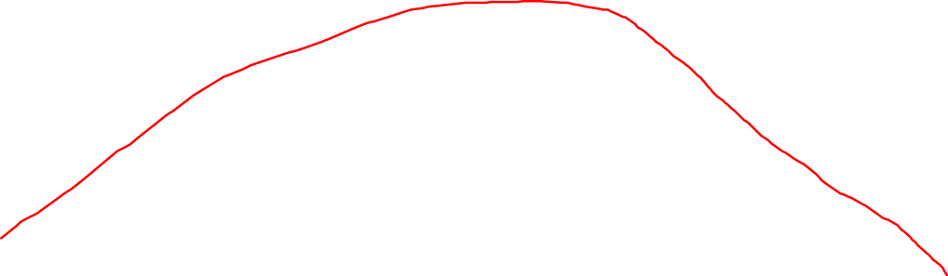
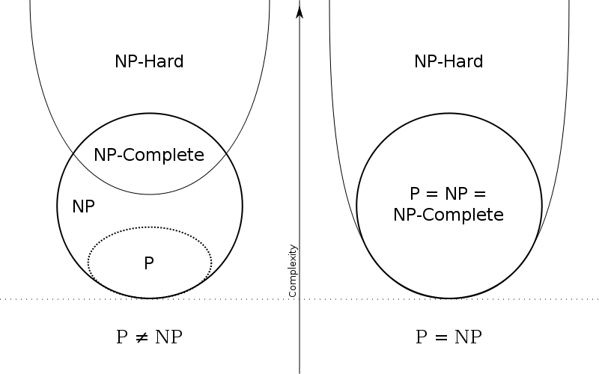
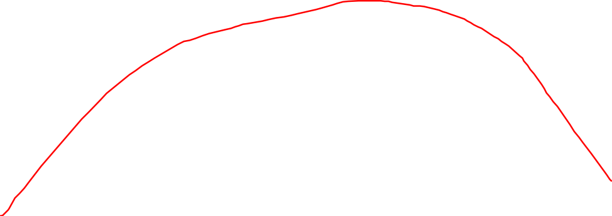
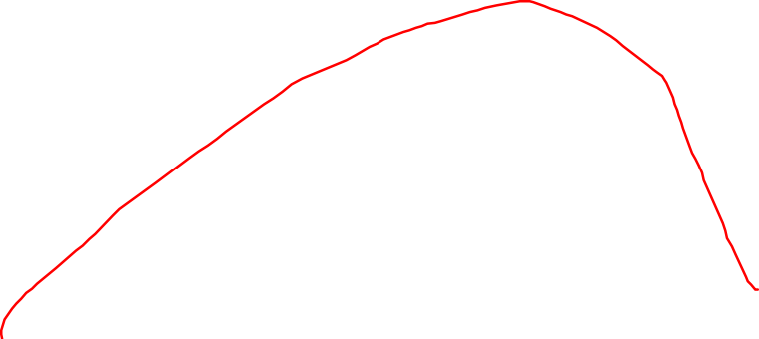



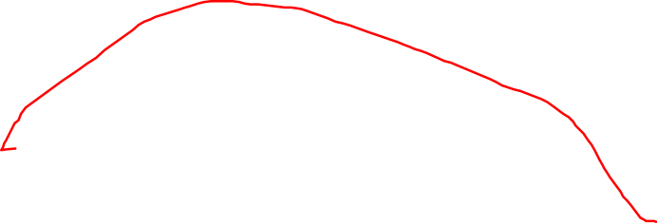



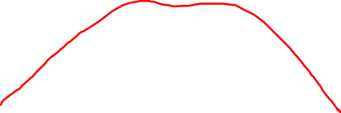
Location of NP-completeness

Slide 49
coNP
A language L is in coNP if its complement is in NP.
Example:
TAUT = {<p>: p is a tautology which is Boolean formula satisfied by every assignment}

